Slide 1


CMPE 180-92 Data Structures and Algorithms in C++ February 23 Class Meeting
Department of Computer Engineering San Jose State University Spring 2017 Instructor: Ron Mak
www.cs.sjsu.edu/~mak

Slide 2
Practice #3-5 Sample Solution
double neighbor_average(const vector<vector<int>>& v, int i, int j)
{
int count = 0;
int sum = 0;
int width = v[i].size();
int height = v.size();
for (int di = -1; di <= 1; di++)
{
int ix = i + di;
for (int dj = -1; dj <= 1; dj++)
{
int jx = j + dj;
...
}
}
return sum * 1.0 / count;
}

Slide 3
Practice #3-5 Sample Solution, cont’d
for (int dj = -1; dj <= 1; dj++)
{
int jx = j + dj;
if ( ((ix != i) || (jx != j)) // not the cell itself
&& (ix >= 0) && (ix < height) // neighbors
&& (jx >= 0) && (jx < width))
{
count++;
sum += v[ix][jx];
}
}

Slide 4
Practice #4-4 Sample Solution
void repeat(const char* str, int n, char result[], int sz)
{
if (sz <= 0) return;
int len = strlen(str);
char* p = result;
for (int i = 0; i < n && p < result + sz; i++)
{
int n = min((int) (result + sz - p), len);
strncpy(p, str, n);
p += n;
}
result[sz - 1] = '\0';
}
HelloHello
Expected: HelloHello
GoodbyeGo
Expected: GoodbyeGo
Goo
Expected: Goo
""
Expected: ""
"x"
Expected: "x"

Slide 5
Assignment #4 Sample Solution
#include <iostream>
#include <iomanip>
#include <mpir.h>
#include <stdlib.h>
#include <string.h>
...
void root4(mpf_t& root4, const mpf_t& x);
void power4(mpf_t& xxxx, const mpf_t& x);
void print(const mpf_t& pi);
/**
* The main.
* Set constants, initialize variables, and iterate
* to compute pi to the desired number of decimal places.
*/
int main()
{
mpf_set_default_prec(BIT_COUNT*PRECISION); // precision in bits
...

Slide 6
Assignment #4 Sample Solution, cont’d
int main()
{
mpf_set_default_prec(BIT_COUNT*PRECISION); // precision in bits
mpf_t one, two, four, six, sqrt2, sqrt2x4;
mpf_t y, y_prev, a, a_prev, y4, yRoot4, aTerm, powers2, y2;
// Multiple-precision constants.
mpf_init(one); mpf_set_str(one, "1", BASE);
mpf_init(two); mpf_set_str(two, "2", BASE);
mpf_init(four); mpf_set_str(four, "4", BASE);
mpf_init(six); mpf_set_str(six, "6", BASE);
// The square root of 2 and four times the square root of 2.
mpf_init(sqrt2); mpf_sqrt(sqrt2, two);
mpf_init(sqrt2x4); mpf_mul(sqrt2x4, four, sqrt2);

Slide 7
Assignment #4 Sample Solution, cont’d
// Multiple-precision variables.
mpf_init(y);
mpf_init(y_prev); mpf_sub(y_prev, sqrt2, one);
mpf_init(a);
mpf_init(a_prev); mpf_sub(a_prev, six, sqrt2x4);
mpf_init(y4);
mpf_init(yRoot4);
mpf_init(aTerm);
mpf_init(powers2); mpf_set_str(powers2, "2", BASE);
mpf_init(y2);
// Loop MAX_ITERATIONS times.
for (int i = 1; i <= MAX_ITERATIONS; i++)
{
// Compute y^4
power4(y4, y_prev);
mpf_t temp1, temp2;
mpf_init(temp1);
mpf_init(temp2);

Slide 8
Assignment #4 Sample Solution, cont’d
// Compute the fourth root of (1 - y^4)
mpf_sub(temp1, one, y4);
root4(yRoot4, temp1);
// Compute y
mpf_sub(temp1, one, yRoot4);
mpf_add(temp2, one, yRoot4);
mpf_div(y, temp1, temp2);
// Compute a*(1 + y)^4
mpf_add(temp1, one, y);
power4(temp2, temp1);
mpf_mul(aTerm, a_prev, temp2);
// Compute 2^(2*i + 1)
mpf_mul(powers2, four, powers2);
// Compute y^2
mpf_mul(y2, y, y);

Slide 9
Assignment #4 Sample Solution, cont’d
// Compute a
mpf_add(temp1, one, y);
mpf_add(temp1, temp1, y2);
mpf_mul(temp1, temp1, y);
mpf_mul(temp1, temp1, powers2);
mpf_sub(a, aTerm, temp1);
mpf_set(a_prev, a);
mpf_set(y_prev, y);
}
mpf_t pi;
mpf_init(pi);
// Compute pi = 1/a
mpf_div(pi, one, a);
print(pi);
return 0;
}

Slide 10
Assignment #4 Sample Solution, cont’d
/**
* Compute the 4th root of a multiple-precision number x.
* @param root4 the computed multiple-precision 4th root of x.
* @param x the multiple-precision number.
*/
void root4(mpf_t& root4, const mpf_t& x)
{
mpf_t root2;
mpf_init(root2);
mpf_sqrt(root2, x);
mpf_sqrt(root4, root2);
}

Slide 11
Assignment #4 Sample Solution, cont’d
/**
* Compute the 4th power of a multiple-precision number x.
* @param xxxx the computed multiple-precision 4th power of x.
* @param x the multiple-precision number.
*/
void power4(mpf_t& xxxx, const mpf_t& x)
{
mpf_t xx;
mpf_init(xx);
mpf_mul(xx, x, x);
mpf_mul(xxxx, xx, xx);
}

Slide 12
Assignment #4 Sample Solution, cont’d
/**
* Print the decimal places of a multiple-precision number x.
* @param pi the multiple-precision number to print.
*/
void print(const mpf_t& pi)
{
mp_exp_t exp; // exponent (not used)
// Convert the multiple-precision number x to a C string.
char *str = NULL;
char *s = mpf_get_str(str, &exp, BASE, PRECISION, pi);
char *p = s+1; // skip the 3 before the decimal point
cout << endl;
cout << "3.";
char block[BLOCK_SIZE + 1]; // 1 extra for the ending \0

Slide 13
Assignment #4 Sample Solution, cont’d
// Loop for each line.
for (int i = 1; i <= LINE_COUNT; i++)
{
// Loop to print blocks of digits in each line.
for (int j = 0; j < LINE_SIZE; j += BLOCK_SIZE)
{
strncpy(block, p+j, BLOCK_SIZE);
block[BLOCK_SIZE] = '\0';
cout << block << " ";
}
cout << endl << " ";
// Print a blank line for grouping.
if (i%GROUP_SIZE == 0) cout << endl << " ";
p += LINE_SIZE;
}
free(s);
}

Slide 14
Structures
A structure represents a collection of values that can be of different data types.
We want to treat the collection as a single item.
Example:
structure tag
struct Employee
{
int id;
string first_name;
string last_name;
double salary;
};
members

Slide 15
Structures are Types
struct Employee
{
int id;
string first_name;
string last_name;
double salary;
}
john
id
98765
first_name
“John”
last_name
“Johnson”
A structure is a type:
salary
75000.00
Employee mary, john;
mary.id = 12345;
mary.first_name = "Mary";
mary.last_name = "Poppins";
mary.salary = 150000.25;
mary.salary = 1.10*mary.salary;
mary
id
12345
first_name
“Mary”
last_name
“Poppins”
salary
150000.25

Slide 16
Scope of Structure Member Names
Two different structure types can contain members with the same name:
To access the value of one of the structure’s members, use a member variable such as mary.salary
struct Employee
{
int id;
...
};
struct Student
{
int id;
...
};

Slide 17
Structure Variables
If you have two variables of the same structure type, you can assign one to the other:
This is equivalent to:
john = mary;
john.id = mary.id;
john.first_name = mary.first_name;
john.last_name = mary.last_name;
john.salary = mary.salary;

Slide 18
Structure Variables, cont’d
An array of employees:
Pass a structure variable to a function:
Return a structure value:
Employee team[10];
team[4].id = 39710;
team[4].first_name = "Sally";
void foo(Employee emp1, Employee& emp2);
Employee find_employee(int id);

Slide 19
Structure Variables, cont’d
Pointer to a structure:
Nested structures:
Employee *emp_ptr;
emp_ptr = new Employee;
(*emp_ptr).id = 192837;
emp_ptr->salary = 95000.00;
struct Employee
{
int id;
string first_name;
string last_name;
double salary;
Birthday bday;
};
struct Birthday
{
int month, day, year;
};
Employee tom;
tom.bday.year = 1992;

Slide 20
Break

Slide 21
Object-Oriented Programming
Object-oriented programming (OOP) is about
encapsulation
inheritance
polymorphism
Work with values called objects.
Objects have methods that operate on the objects.
Example: A string is an object. Strings have a length method, so that if str is a string variable, then str.length() is the length of its string value.
Combine variables and functions into a single class.

Slide 22
Classes
A class is a data type whose values are objects.
Like structure types, you can define your own class types.
A class type definition includes both member variables and declarations of member functions.
Example:
class Birthday
{
public:
int month, day, year;
void print();
};

Slide 23
Defining Member Functions
Define member functions outside of the class definition:
Scope resolution operator ::
class Birthday
{
public:
int month, day, year;
void print();
};
void Birthday::print()
{
cout << month << "/" << day << "/" << year << endl;
}

Slide 24
Public and Private Members
Members of a class are either public or private.
Private members of a class can be accessed only by member functions of the same class.
You can provide public getters and setters for any private member variables.
AKA accessors and mutators
A member function (public or private) can be labelled const.
It will not modify the value of any member variable.

Slide 25
Public and Private Members, cont’d
class Birthday
{
public:
int get_year();
int get_month();
int get_day();
int get_year() const;
int get_month() const;
int get_day() const;
void print();
private:
int year, month, day;
};

Slide 26
Public and Private Members, cont’d
int Birthday::get_year() const { return year; }
int Birthday::get_month() const { return month; }
int Birthday::get_day() const { return day; }
void Birthday::set_year(int y) { year = y; }
void Birthday::set_month(int m) { month = m; }
void Birthday::set_day(int d) { day = d; }
void Birthday::print() const
{
cout << month << "/" << day << "/" << year << endl;
}

Slide 27
Public and Private Members, cont’d
int main()
{
Birthday bd;
bd.set_year(1990);
bd.set_month(9);
bd.set_day(2);
bd.print();
}
9/2/1990

Slide 28
Constructors
A class can define special member functions called constructors that initialize the values of member variables.
A constructor has the same name as the class itself.
It has no return type, not even void.
The default constructor has no parameters.
A constructor is called automatically whenever an object of the class is declared.

Slide 29
Constructors, cont’d
class Birthday
{
public:
// Constructors
Birthday();
Birthday(int y, int m, int d);
...
}
Birthday::Birthday() : year(0), month(0), day(0)
{
// Default constructor with an empty body
}
Birthday::Birthday(int y, int m, int d) : year(y), month(m), day(d)
{
// Empty body
}

Slide 30
Constructors, cont’d
int main()
{
Birthday bd1; // call default constructor
Birthday bd2(1990, 9, 2); // call constructor
bd1.print();
bd2.print();
}
0/0/0
9/2/1990
Do not write:
That is a declaration of a function named bd1 that returns a value of type Birthday.
Birthday bd1();

Slide 31
Constructors, cont’d
If you provided no constructors for a class, the C++ compiler will generate a default constructor that does nothing.
However, if you provided at least one constructor for the class, the compiler will not generate a default constructor.

Slide 32
Constructors, cont’d
Suppose you are provided this constructor only:
Then the following object declaration is illegal:
Birthday(int y, int m, int d);
Birthday bd1;

Slide 33
Friend Functions
class Birthday
{
public:
// Constructors
Birthday();
Birthday(int y, int m, int d);
int get_year() const;
int get_month() const;
int get_day() const;
void set_year(int y);
void set_month(int m);
void set_day(int d);
void print();
private:
int year, month, day;
};
Write a function that is external to the class (i.e., not a member function) that compares two birthdays for equality.

Slide 34
Friend Functions, cont’d
bool equal(const Birthday& bd1, const Birthday& bd2)
{
return (bd1.get_year() == bd2.get_year())
&& (bd1.get_month() == bd2.get_month())
&& (bd1.get_day() == bd2.get_day());
}
Function equal must call the accessor (getter) methods because year, month, and day are private member variables.
Make function equal a friend of class Birthday to allow the function to access the private member variables directly.

Slide 35
Friend Functions, cont’d
class Birthday
{
public:
// Constructors
Birthday();
Birthday(int y, int m, int d);
int get_year() const;
int get_month() const;
int get_day() const;
void set_year(int y);
void set_month(int m);
void set_day(int d);
void print();
friend bool equal(const Birthday& bd1, const Birthday& bd2);
private:
int year, month, day;
};
Because it is a friend of the class,
function equal can now access
private members.
bool equal(const Birthday& bd1,
const Birthday& bd2)
{
return (bd1.year == bd2.year)
&& (bd1.month == bd2.month)
&& (bd1.day == bd2.day);
}
Have both friend functions
and accessor functions.

Slide 36
Operator Overloading
How many years apart are two birthdays?
We can write a function years_apart that takes two birthdays and subtracts their years:
class Birthday
{
public:
...
friend bool equal(const Birthday& bd1, const Birthday& bd2);
friend int years_apart(const Birthday& bd1, const Birthday& bd2);
...
};
int years_apart(const Birthday& bd1, const Birthday& bd2)
{
return abs(bd1.year - bd2.year);
}

Slide 37
Operator Overloading, cont’d
Overload the subtraction operator and make operator - a friend function.
class Birthday
{
public:
...
friend bool equal(const Birthday& bd1, const Birthday& bd2);
friend int years_apart(const Birthday& bd1, const Birthday& bd2);
friend int operator -(const Birthday& bd1, const Birthday& bd2);
...
};
int operator -(const Birthday& bd1, const Birthday& bd2)
{
return abs(bd1.year - bd2.year);
}

Slide 38
Operator Overloading, cont’d
int main()
{
Birthday bd1; // call default constructor
Birthday bd2(1990, 9, 2); // call constructor
Birthday bd3(2001, 5, 8); // call constructor
bd1.print();
bd2.print();
cout << years_apart(bd2, bd3) << endl;
cout << bd2 - bd3 << endl;
}
0/0/0
9/2/1990
11
11

Slide 39
Overload <<
You can overload the stream insertion operator.
Suppose you want a Birthday object to be output in the form month/day/year.
class Birthday
{
public:
...
friend ostream& operator <<(ostream& outs, const Birthday& bd);
...
};
friend ostream& operator <<(ostream& outs, const Birthday& bd)
{
outs << bd.month << "/" << bd.day << "/" << bd.year << endl;
return outs;
}

Slide 40
Overload <<, cont’d
int main()
{
Birthday bd1; // call default constructor
Birthday bd2(1990, 9, 2); // call constructor
Birthday bd3(2001, 5, 8); // call constructor
cout << bd1 << ", " << bd2 << ", " << bd3 << endl;
}
0/0/0, 9/2/1990, 5/8/2001

Slide 41
Overload >>
You want to input birthdays in the format
Example: {1993, 9, 2}
Overload the stream extraction operator.
{year, month, day}
class Birthday
{
public:
...
friend istream& operator >>(istream& ins, Birthday& bd);
...
};

Slide 42
Overload >>, cont’d
istream& operator >>(istream& ins, Birthday& bd)
{
int y, m, d;
char ch;
ins >> ch;
if (ch == '{')
{
ins >> y;
ins >> ch;
if (ch == ',')
{
ins >> m;
ins >> ch;
if (ch == ',')
{
ins >> d;
ins >> ch;
if (ch == '}')
{
bd.year = y;
bd.month = m;
bd.day = d;
}
}
}
}
return ins;
}
int main()
{
Birthday bd1;
Birthday bd2;
cout << "Enter two birthdays: ";
cin >> bd1 >> bd2;
cout << bd1 << ", " << bd2 << endl;
}
Enter two birthdays: {1953, 9, 2} {1957, 4, 3}
9/2/1953, 4/3/1957
Error checking needed!

Slide 43
Abstract Data Types
A data type specifies:
what values are allowed
what operations are allowed
An abstract data type (ADT):
allows its values and operations to be used
hides how the values and operations are implemented
Example: The predefined type int is an ADT.
You can use integers and the operators + - * / %
But you don’t know how they’re implemented.

Slide 44
Abstract Data Types, cont’d
To make your class an ADT, you must separate:
The specification of how a type is used.
The details of how the type is implemented.
To ensure this separation:
Make all member variables private.
Make public all the member functions that a programmer needs to use, and fully specify how to use each one.
Make private all helper member functions.
Is the Birthday class an ADT?

Slide 45
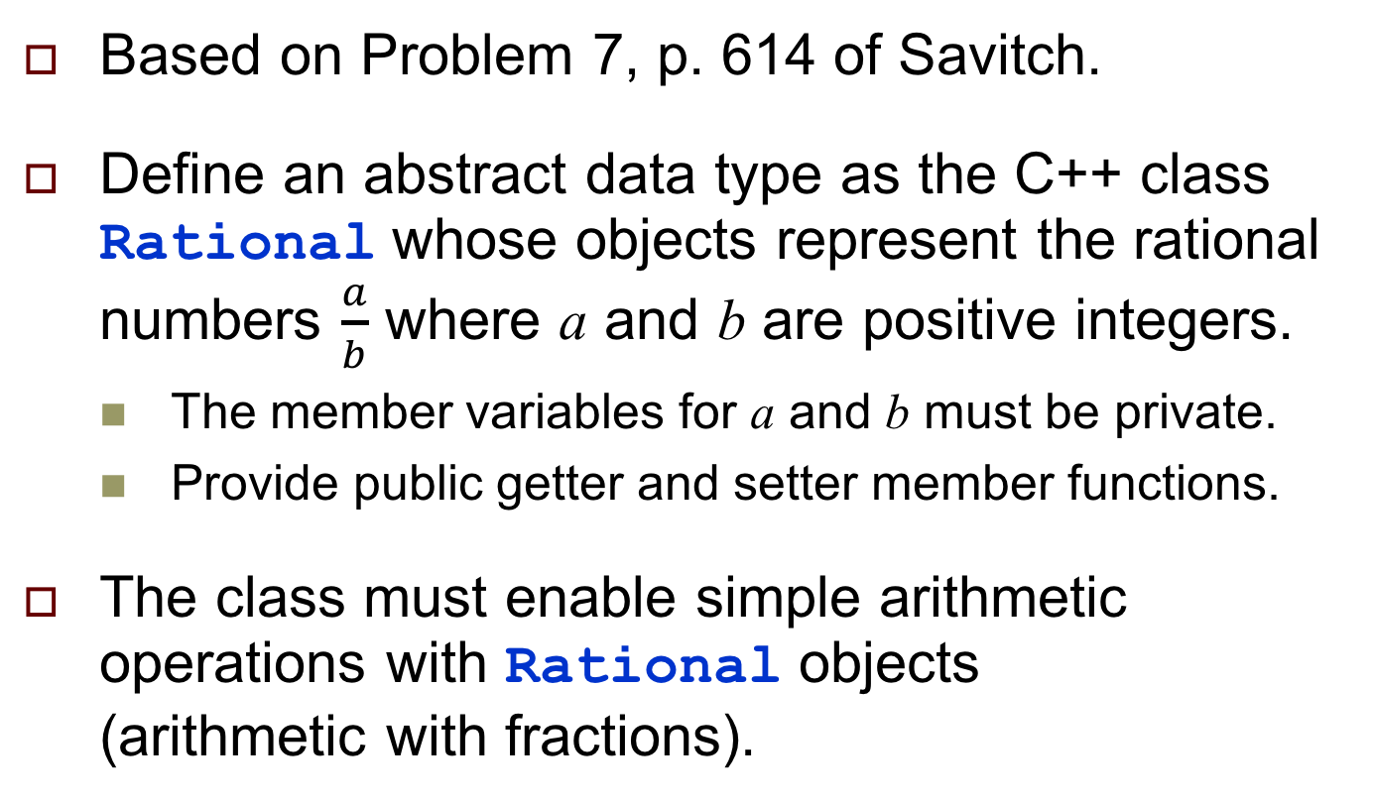
Assignment #5. Rational Numbers
Based on Problem 7, p. 614 of Savitch.
Define an abstract data type as the C++ class Rational whose objects represent the rational numbers $\frac{a}{b}$ where a and b are positive integers.
The member variables for a and b must be private.
Provide public getter and setter member functions.
The class must enable simple arithmetic operations with Rational objects (arithmetic with fractions).

Slide 46
Assignment #5, cont’d
Class Rational must have three constructors:
A constructor that creates a Rational object out of two integer arguments.
A constructor that takes a single integer argument and creates a Rational object that represents a whole number (the value of b is 1).
A default constructor that creates a Rational object that represents the value 0.

Slide 47
Assignment #5, cont’d
Overload the + - * and / operators to operate on Rational objects.
For example, if r1 and r2 are Rational objects, then r1 + r2 should return a Rational object as the sum.
Overload the >> extraction operator to input a Rational object in the form (a/b), or just a for a whole number, where a and b are positive integers.

Slide 48
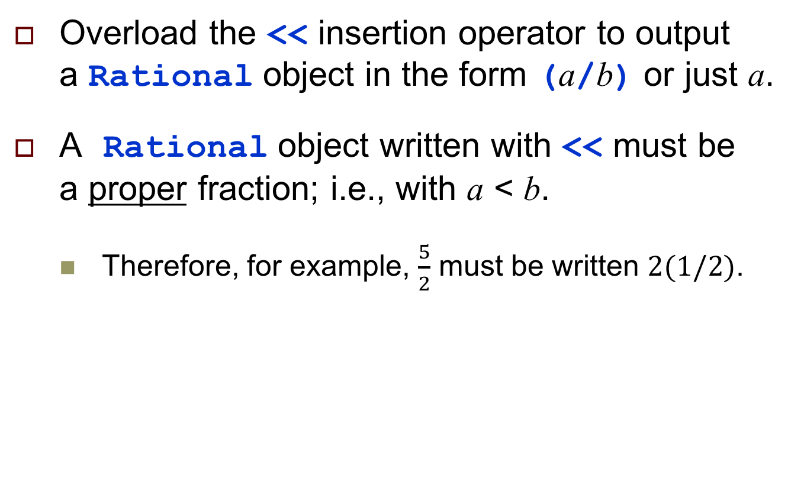
Assignment #5, cont’d
Overload the << insertion operator to output a Rational object in the form (a/b) or just a.
A Rational object written with << must be a proper fraction; i.e., with a < b.
Therefore, for example, $\frac{5}{2}$ must be written 2($1/2$).

Slide 49
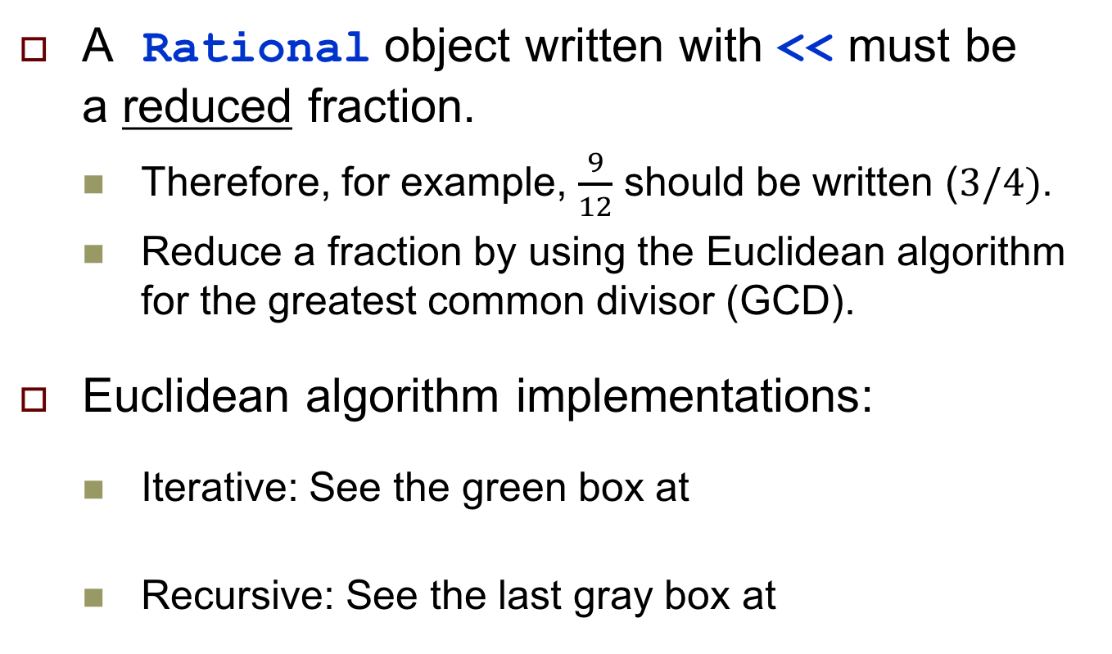
Assignment #5, cont’d
A Rational object written with << must be a reduced fraction.
Therefore, for example, $\frac{9}{12}$ should be written ($3/4)$.
Reduce a fraction by using the Euclidean algorithm for the greatest common divisor (GCD).
Euclidean algorithm implementations:
Iterative: See the green box at
Recursive: See the last gray box at
https://www.math.rutgers.edu/~greenfie/gs2004/euclid.html
http://stackoverflow.com/questions/28267611/using-euclid-algorithm-to-find-gcfgcd

Slide 50
Assignment #5, cont’d
Your program must be able to input a file containing simple arithmetic problems to solve.
Each line will contain a problem r1 op r2 where r1 and r2 are Rational objects in the form suitable to be read by >> and op is + - * or /.
Print the contents of each input line followed by = and the answer.
Due Thursday, March 2 at 5:30 PM.
Full assignment write-up and input file to be provided.

